Slide 1
Stablishing credibility in scholarly sources

Slide 2
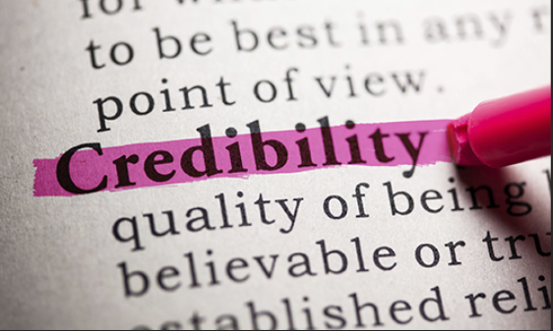
The ABCs of scholarly sources
Aim
When doing research, it’s important to ensure that the sources you select are credible. In this lesson, you will begin learning how to identify scholarly source material for academic research.

Slide 3
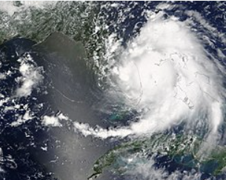
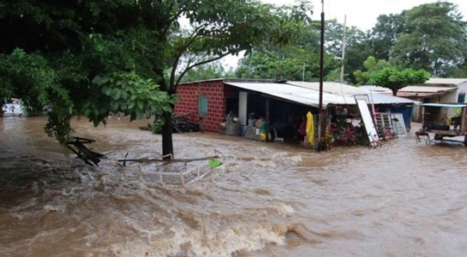

The ABCs of scholarly sources

Slide 4

The ABCs of scholarly sources
Ensure your sources are credible.
Identify scholarly source material for academic research.

Slide 5
The ABCs of scholarly sources
Key indicators
Authority
Bias
Author

Slide 6
The ABCs of scholarly sources
Key indicators
Authority
Author
Credentials
Affiliation
Author/Editor
Organization as author
Lizarazo Ivan and Leon Nohra
Daniel Hurtado, professor emeritus
Marty jones, Harvard University
Edited by Noel Castree
The XYZ author

Slide 7
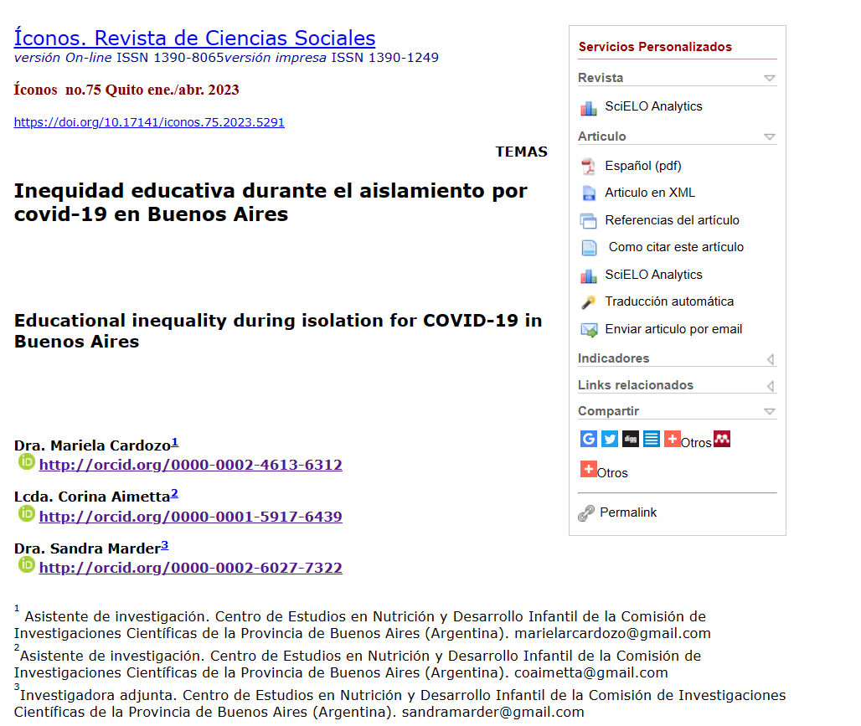
The ABCs of scholarly sources
Key indicators
Authority
Author
Credentials
Affiliation
Author/Editor
Organization as author

Slide 8
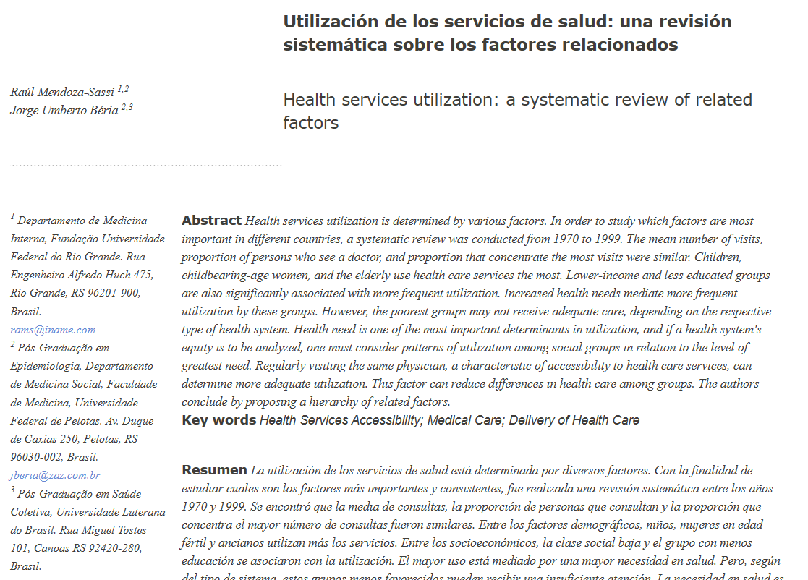

The ABCs of scholarly sources
Key indicators
Authority
Author
Credentials
Affiliation
Author/Editor
Organization as author

Slide 9

The ABCs of scholarly sources
Key indicators
BIAS
Peer review
Same field
Objectivity
Familiarity
Neutrality

Slide 10
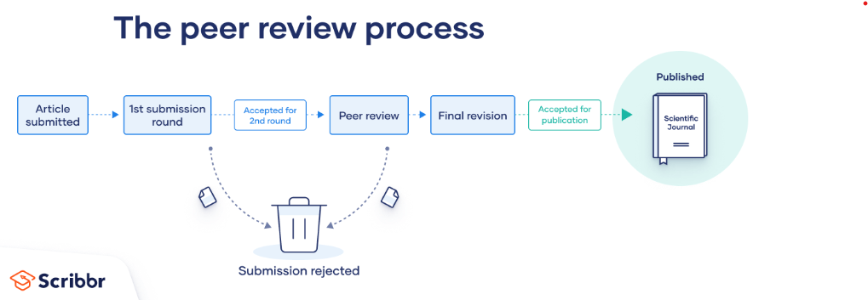
The ABCs of scholarly sources
Key indicators
BIAS
Peer review
Same field
Objectivity
Familiarity
Neutrality

Slide 11
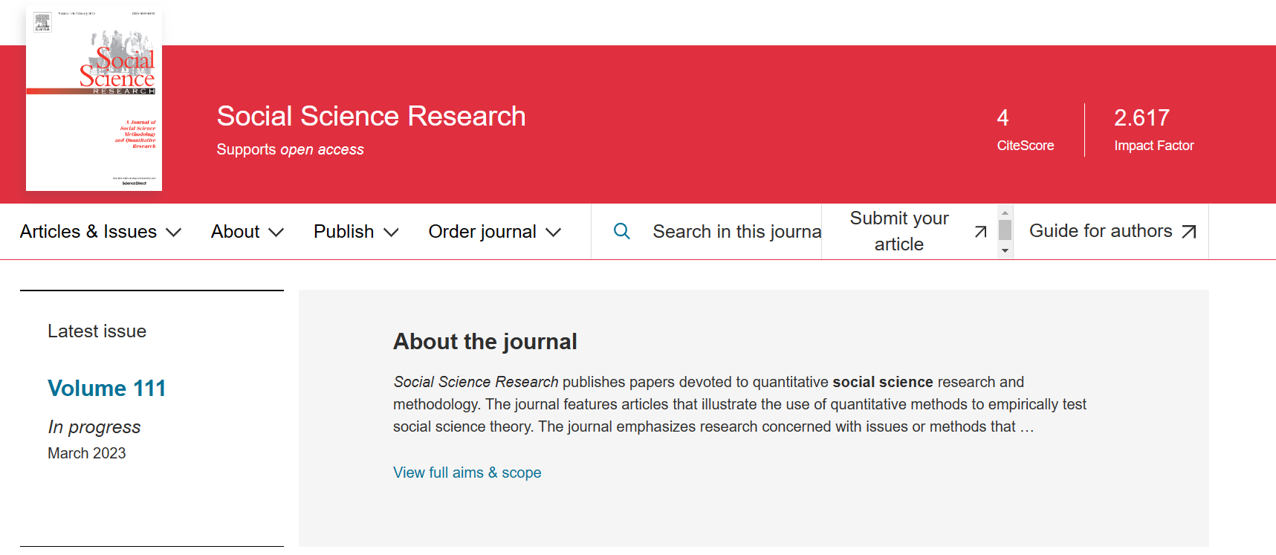
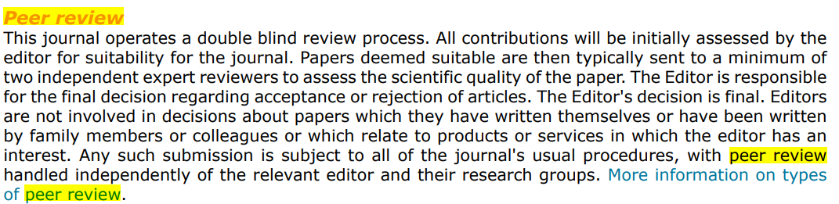
The ABCs of scholarly sources
Key indicators
BIAS
Peer review
Same field
Objectivity
Familiarity
Neutrality

Slide 12
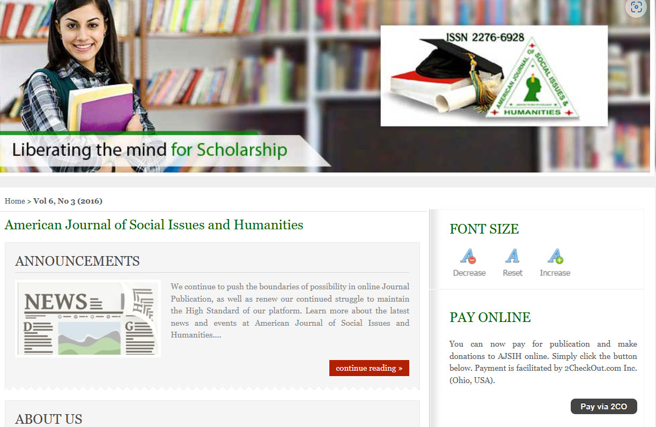
The ABCs of scholarly sources
Key indicators
BIAS
Peer review
Same field
Objectivity
Familiarity
Neutrality

Slide 13
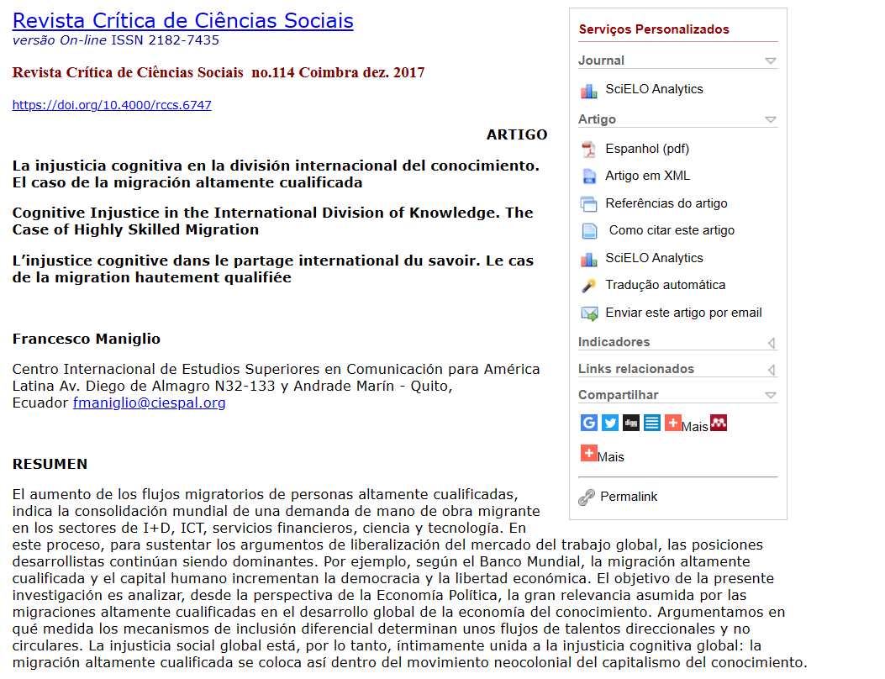
The ABCs of scholarly sources
Key indicators
Content
Audience
Intent
Level
Style
Tone

Slide 14
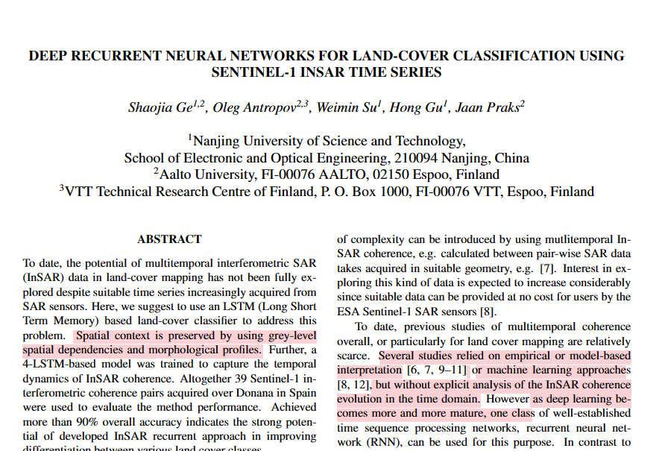

The ABCs of scholarly sources
Key indicators
Content
Audience
Intent
Level
Style
Tone
Tener cuidado con papers de conferencias

Slide 15
The ABCs of scholarly sources
Key indicators
Publisher
Editorial board
Logo
Affiliation and awards
Tone and style

Slide 16
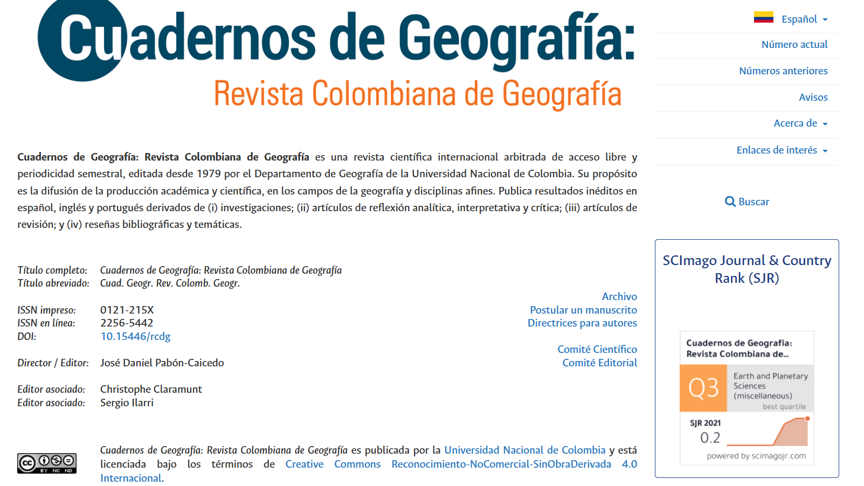
The ABCs of scholarly sources
Key indicators
Publisher
Editorial board
Logo
Affiliation and awards
Tone and style

Slide 17
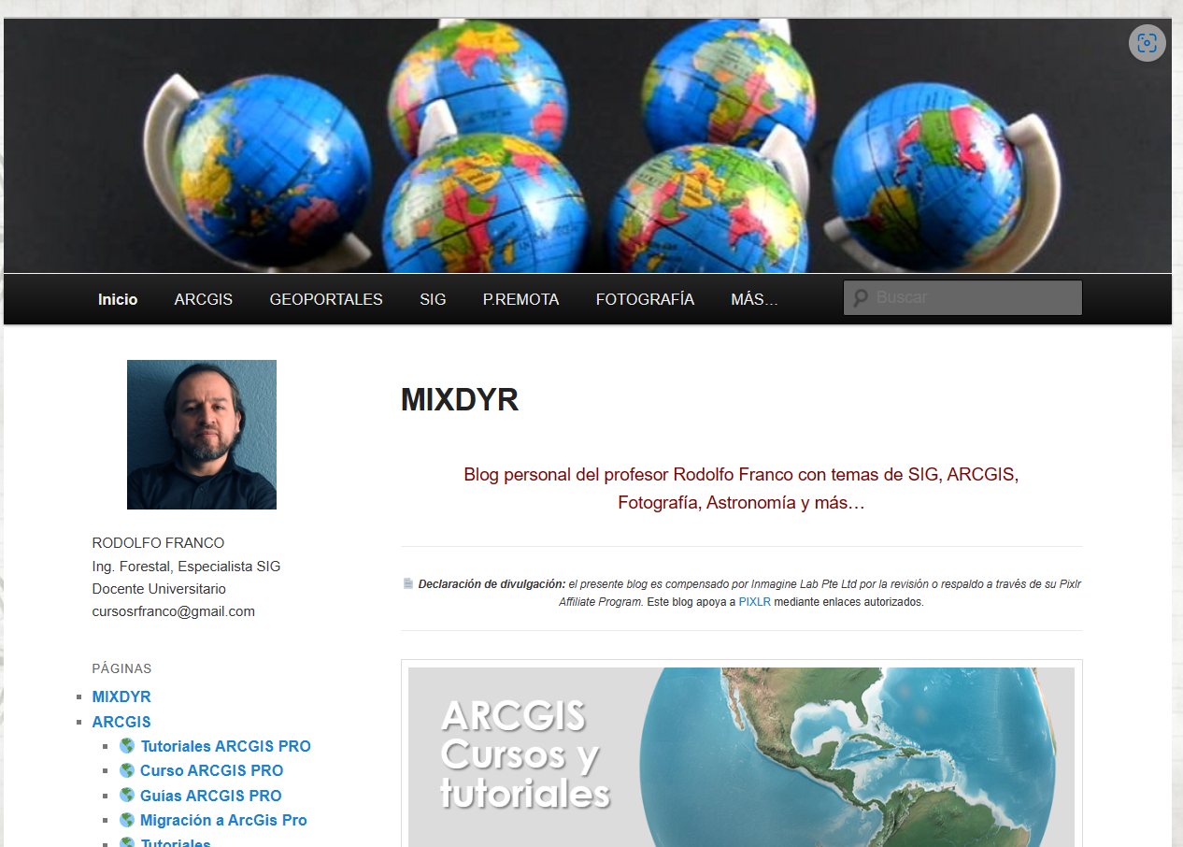
Verifying online sources
Warnings!!
Personal/blog

Slide 18
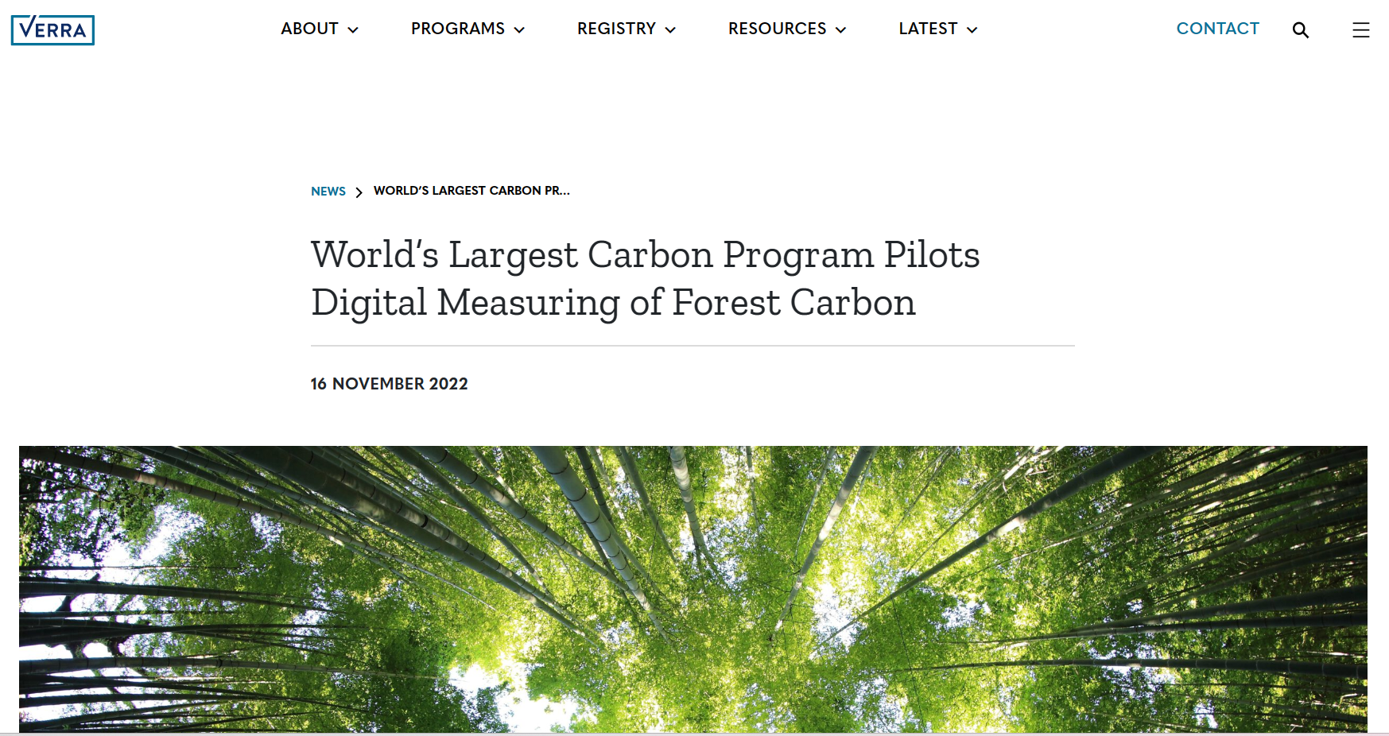
Verifying online sources
Warnings!!
Personal/blog

Slide 19
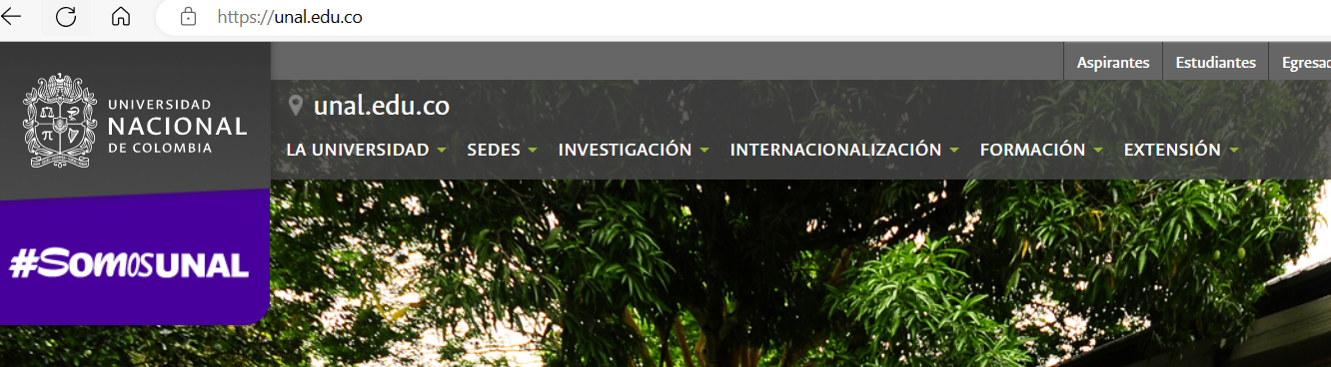
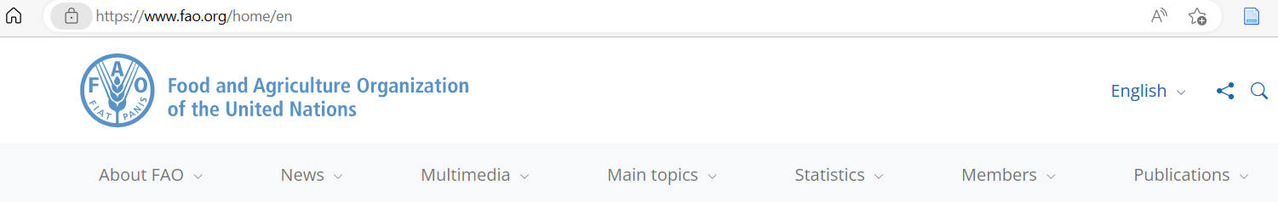
Verifying online sources
Warnings!!
Check the URL
URL: Uniform resource allocator

Slide 20
Verifying online sources
Warnings!!
Check the URL
org: (non-profit organization sites)
.com (company or commercial sites)
.net (internet services providers and other networks)

Slide 21
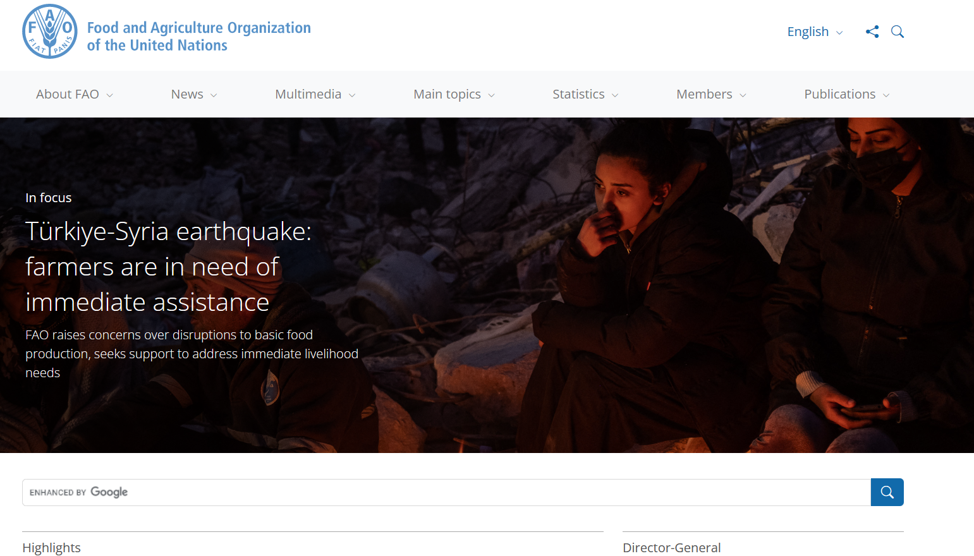
Verifying online sources
Warnings!!
Check the perimeter

Slide 22
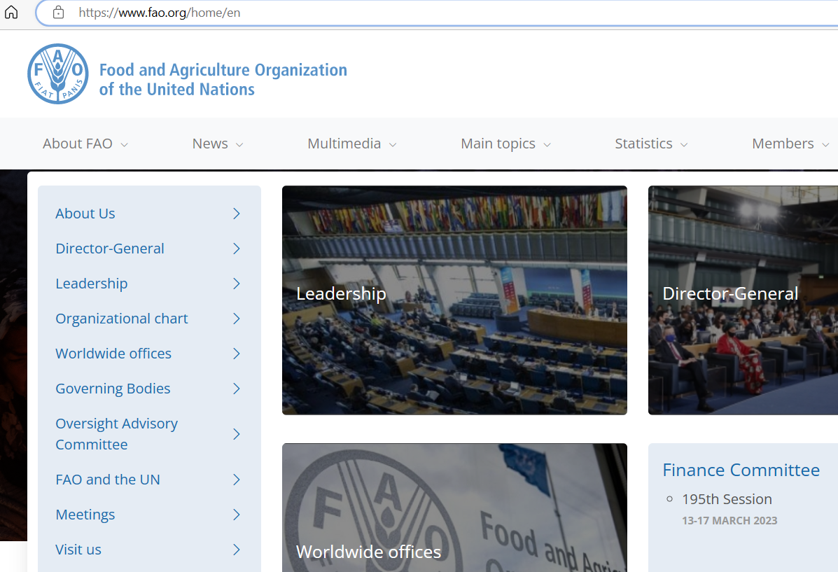
Verifying online sources
Warnings!!
Check the perimeter

Slide 23
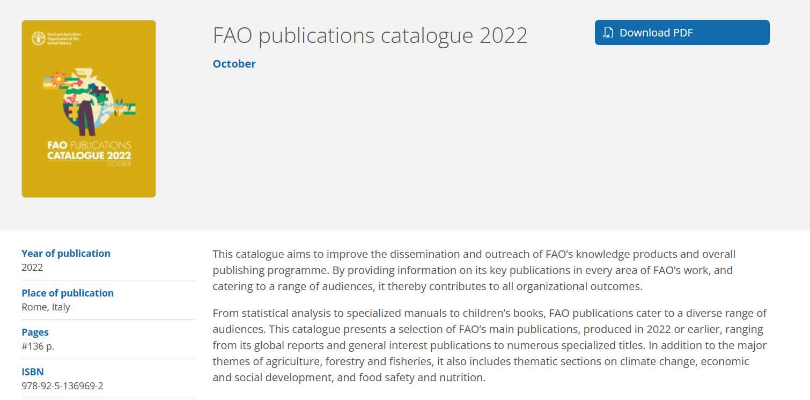
Verifying online sources
Warnings!!
Check the perimeter

Slide 24
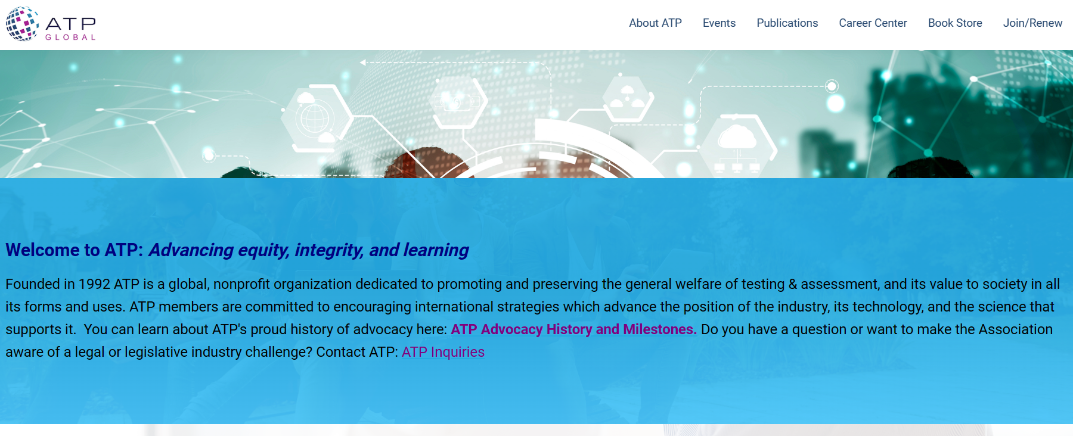
Verifying online sources
Warnings!!
Check the perimeter

Slide 25

Verifying online sources
Warnings!!
Check the perimeter

Slide 26
Verifying online sources
Activity
Take a look at the following URLs and their extensions. Can you tell from the URL what type of organization owns the website?
www.fda.com
Www.mo.gov
www.nytimes.org
www.nytimes.org
www.jhu.edu
www.princeton.com

Slide 27
Verifying online sources
Activity
Take a look at the following URLs and their extensions. Can you tell from the URL what type of organization owns the website?
www.fda.com
Anyone can buy and use a .com URL. You might have recognized FDA as the acronym for the United States Food and Drug Administration, but this is not the agency's website
Www.mo.gov
Only government agencies may use a .gov URL. This is the website for the state of Missouri.
www.nytimes.org
There are no restrictions on the use of a .org URL. This website belongs to the New York Times, a for-profit company.

Slide 28
Verifying online sources
Activity
Take a look at the following URLs and their extensions. Can you tell from the URL what type of organization owns the website?
www.nytimes.org
Unknown: There are no restrictions on the use of a .org URL. This website belongs to the New York Times, a for-profit company.
www.jhu.edu
Only institutions of higher learning, like Johns Hopkins University, may use a .edu URL
www.princeton.com
There are no restrictions on the use of a .com URL. This website belongs to a for-profit consulting firm.

